Slide 1

Hostel Management System
Efficiently managing a hostel involves a multitude of tasks, including student information management, complaint resolution, room allocation, notice management, and canteen menu updates. The Hostel Management System aims to revolutionize hostel administration by providing a user-friendly, automated, and efficient platform to address these specific needs. By streamlining these processes, the system ensures a smoother and more organized hostel experience for both administrators and residents.

Slide 2
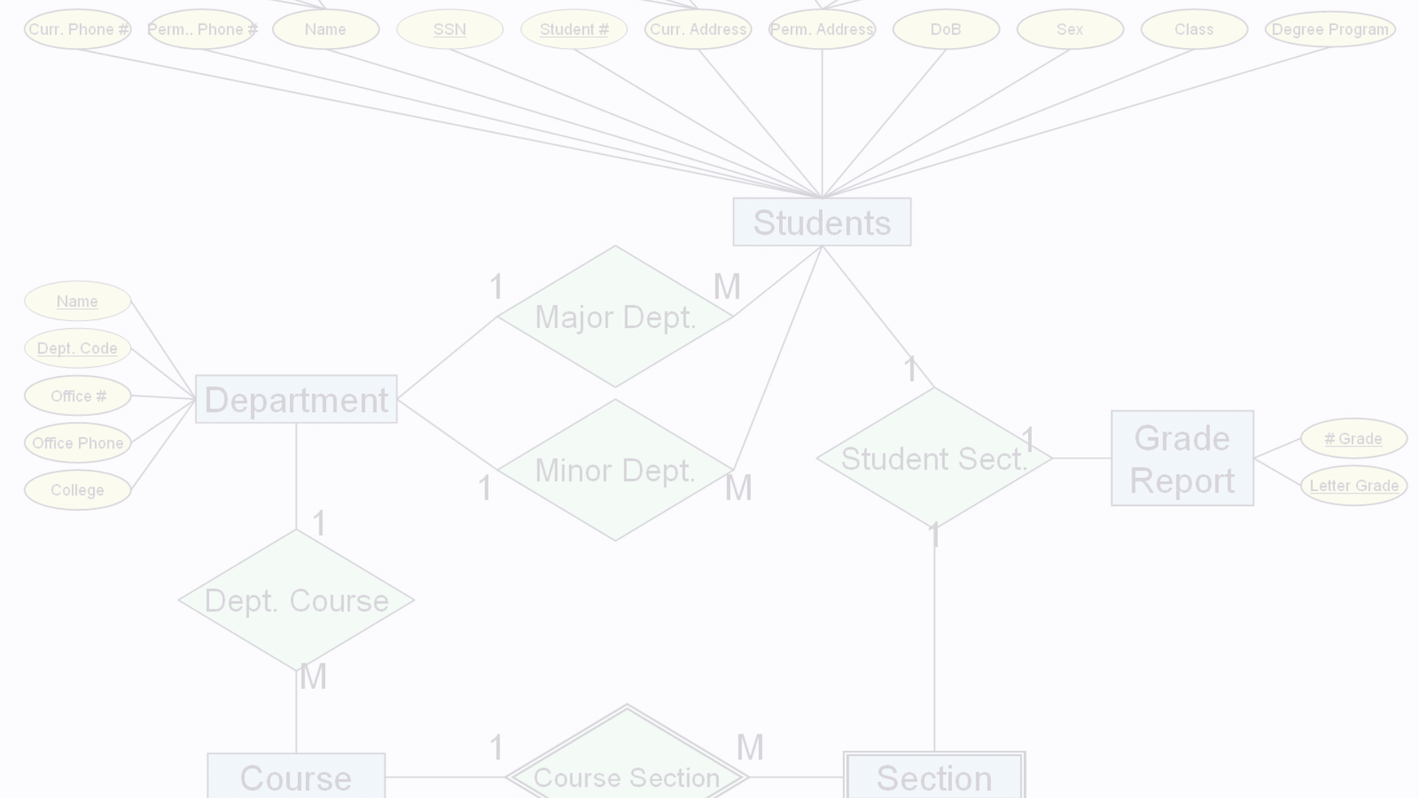
Student Information Management
Accurate Records
Efficient Tracking
Improved Communication
The system enables the addition and editing of student information, maintaining up-to-date and accurate records. Administrators can easily manage student data through a secure and intuitive interface.
By centralizing student information, the system allows for efficient tracking and management of student details, ensuring that all relevant data is readily available and organized.
With comprehensive student information at their fingertips, administrators can communicate more effectively with students, addressing their needs and concerns in a timely manner.

Slide 3
Complaint Resolution
1
Submission
Students can easily submit complaints through the system, providing a convenient and accessible platform to voice their concerns.
2
Review
Hostel staff can efficiently review and address the submitted complaints, ensuring a prompt and effective resolution process.
3
Feedback
The system facilitates communication between students and staff, allowing for timely feedback and updates on the status of their complaints.

Slide 4
Room Allocation
Allocation
Flexible Management
Improved Transparency
The system a the process of room allocation, considering factors such as student preferences and room availability. This streamlines the process and ensures a fair and efficient distribution of rooms.
The system allows for the addition of new rooms as needed, providing flexibility in accommodating changes and growth within the hostel. Administrators can easily manage room assignments and occupancy.
By centralizing the room allocation process, the system enhances transparency and communication, ensuring that students are informed about their room assignments and any changes that may occur.

Slide 5
Notice Management
1
Timely Communication
2
Centralized Platform
3
Improved Engagement
The system integrates a feature to add and edit notices, ensuring that important information reaches hostel residents promptly. This helps maintain effective communication within the hostel community.
By providing a centralized platform for notice management, the system ensures that all relevant information is easily accessible and organized, reducing the risk of missed or overlooked announcements.
The timely and efficient dissemination of notices through the system helps foster a more engaged and informed hostel community, where residents are kept up-to-date on important events and updates.

Slide 6



Canteen Menu Management
Menu Updates
Improved Communication
Resident Satisfaction
The system provides the functionality to add and edit the canteen menu, ensuring that residents are informed about the available food options.
The ability to access the updated canteen menu through the system helps residents make informed choices, contributing to their overall satisfaction with the hostel's dining services.
By centralizing the canteen menu information, the system enhances communication between the hostel administration and residents, allowing for better awareness of the dining options.

Slide 7



Secure and Accessible
Secure Database
The Hostel Management System utilizes a secure database to store and retrieve all the relevant information, ensuring the confidentiality and integrity of the data.
Authorized Access
The system allows administrators, hostel staff, and students to log in with designated roles and permissions, providing a secure and controlled access to the platform.
Accessible Interface
The web-based application is designed to be user-friendly and accessible through any modern web browser, making it convenient for all stakeholders to interact with the system.

Slide 8
Scalable and Extensible
Customization
The Hostel Management System can be customized to fit the specific requirements of different educational institutions, ensuring a tailored solution for each client.
Future Enhancements
The system has the potential for future enhancements, such as integration with RFID or biometric systems for enhanced security, mobile application development, and integration with academic management systems.
Reporting and Analytics
The system can be expanded to include advanced reporting and analytics features, providing data-driven insights to support decision-making and continuous improvement in hostel management.

Slide 9
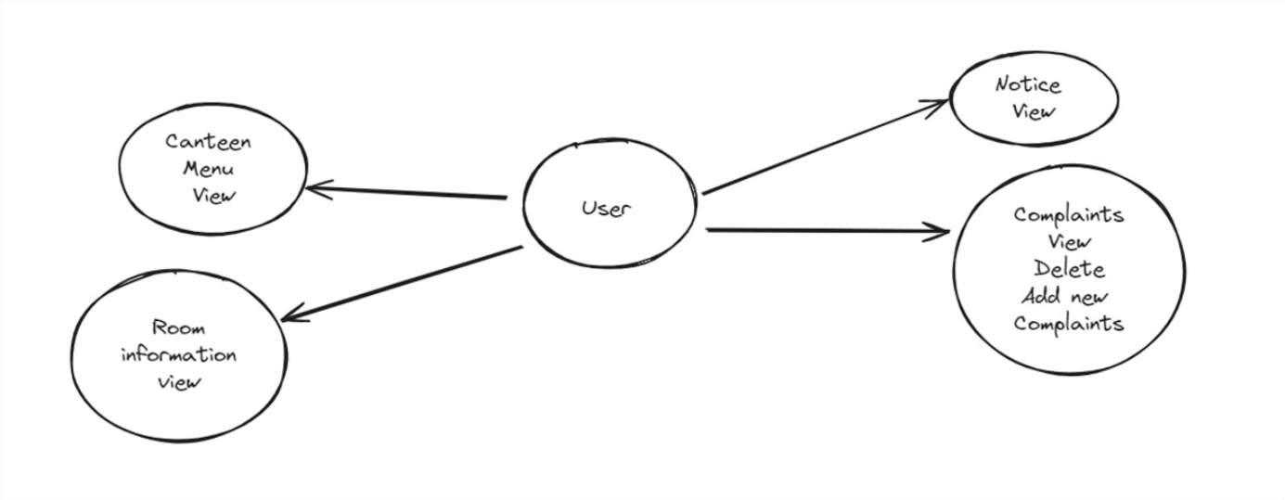
User Flow

Slide 10
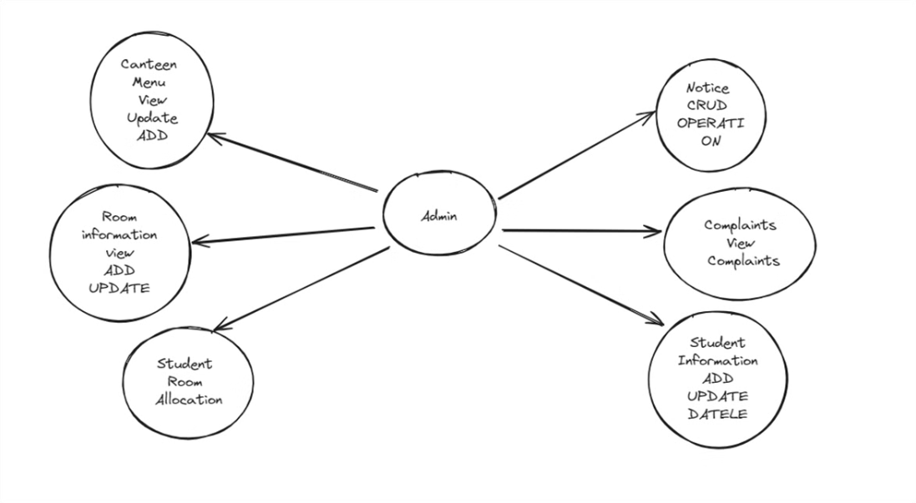
Admin Flow

